Slide 1
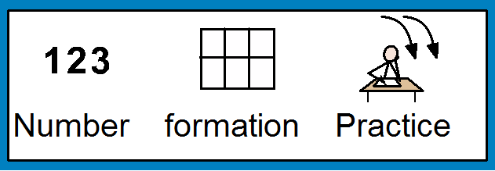
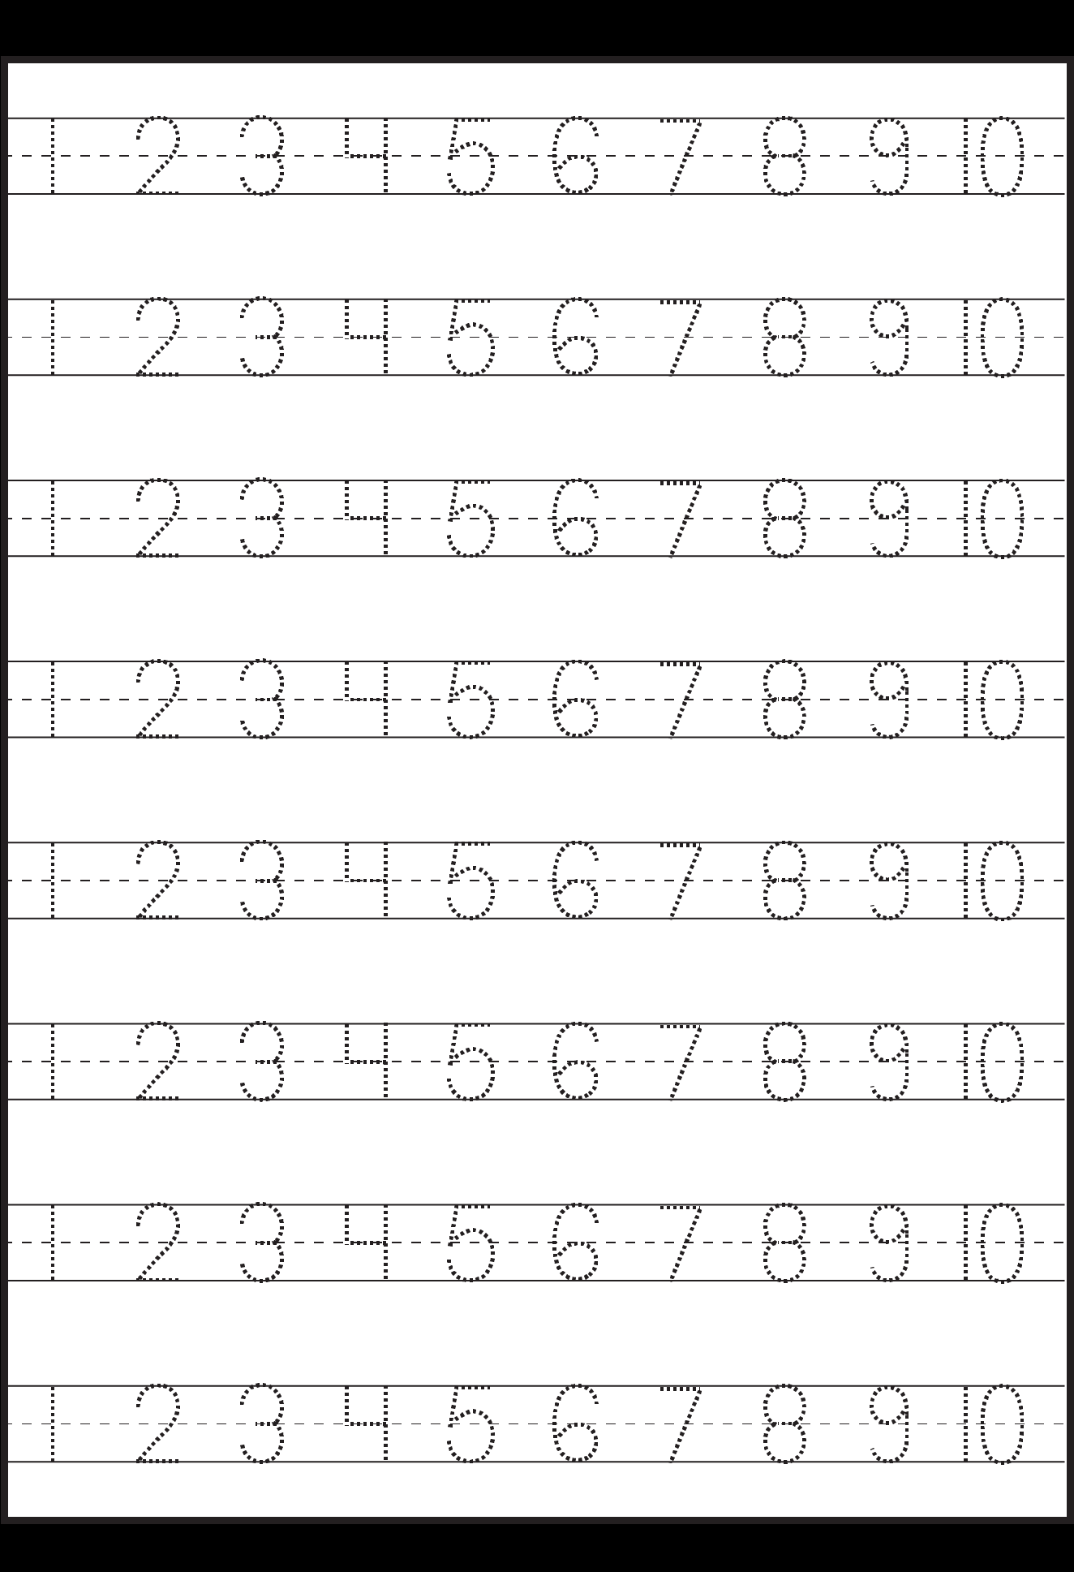
Name:
Date:

Slide 2
Name:
Date:

